Slide 1
Machine Learning Healthcare
Nikos Kefalas
Stavros Tsiloglou

Slide 2
Table of contents
01
Strokes
02
Comparison
03
ML Conclusion
04
Sources-Credits
Gender, Age, WorkType , Habits
Q&A

Slide 3
Strokes
5100
4850
Patients
0. Healthy Patients
250
1. Strokes-Symptoms

Slide 4
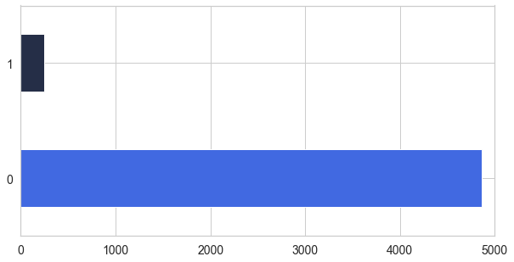

Our statistics

Slide 5
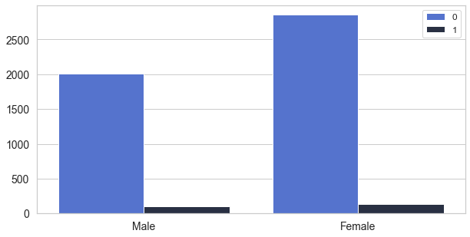

Gender

Slide 6
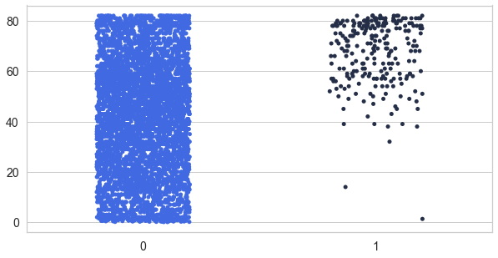

Age

Slide 7

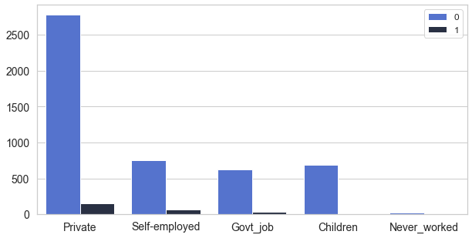
WorkType

Slide 8
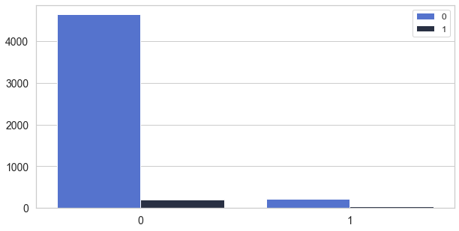

Heart Diseases

Slide 9

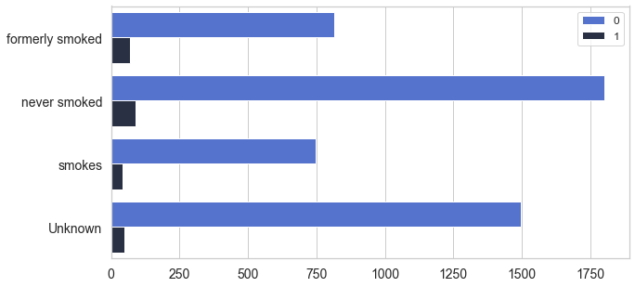
Smoking

Slide 10
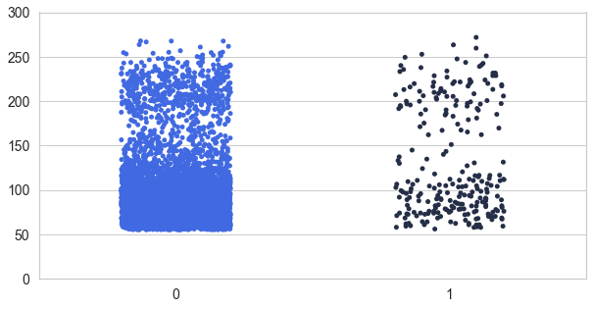

Glucose

Slide 11
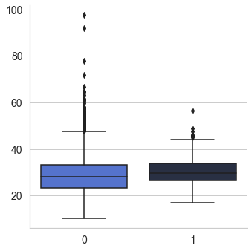

Eating
 | Uweight | Nweight | Oweight | Obesity
BMI | <18.5 | 18.5-24.9 | 25-29.9 | 30<

Slide 12
Confusion Matrix
 | TN | FP
No Stroke | 1160 | 440
 | FN | TP
Stroke | 15 | 65

Slide 13
81 %
WE CAN PREDICT & SAVE

Slide 14
Sources
01
Kaggle
02
Stroke Prediction
03
Google

Slide 15
Special Thanks!!
Do you have any questions?

